Slide 1
HW#3 Review
Wen-Yen Hsu
Dept Electrical Engineering
Chang Gung University, Taiwan

Slide 2

Exercise

Slide 3



One-versus-All (OvA) or One-versus-Rest (OvR)
The perceptron algorithm can be extended to multi-class classification
φ1(x)=0
C1 Not C1
C1 C2
Not C3
φ3(x)=0
C
3
Not C2 C2
φ2(x)=0

Slide 4
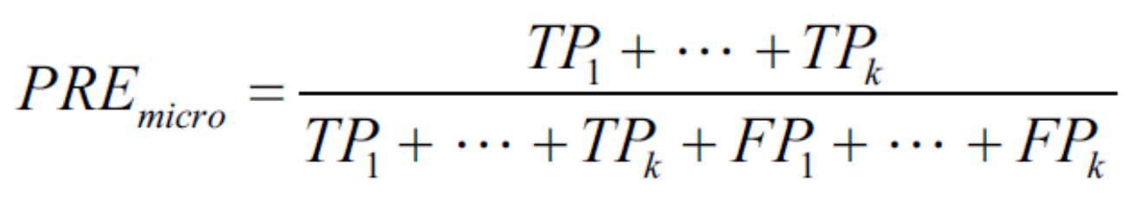
Scoring metrics for multiclass classification
Calculated individual TPs, TNs, FPs, and FNs
Precision score in a k-class system

Slide 5
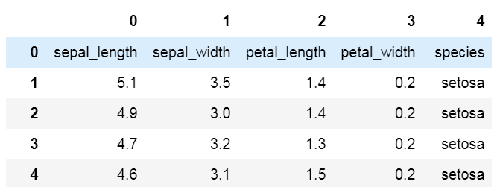
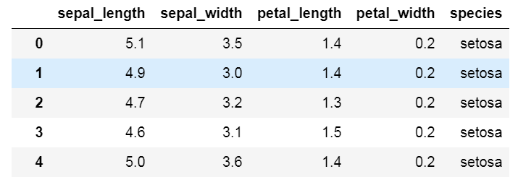
Load data
Header and dtype
header=None header=0
# Read the iris data
df = pd.read_csv('iris.csv', header=0,
dtype={"sepal_length":"float64",
"sepal_width":"float64",
"petal_length":"float64",
"petal_width":"float64",})

Slide 6
Data preprocessing
## Using all features
y = df.iloc[:, 4].values
# print(y)
X = df.iloc[:, [0, 1, 2, 3]].values
X_std = np.copy(X)
X_std[:, 0] = (X[:, 0] - X[:, 0].mean()) / X[:, 0].std()
X_std[:, 1] = (X[:, 1] - X[:, 1].mean()) / X[:, 1].std()
X_std[:, 2] = (X[:, 2] - X[:, 2].mean()) / X[:, 2].std()
X_std[:, 3] = (X[:, 3] - X[:, 3].mean()) / X[:, 3].std()
# print(X_std.shape)

Slide 7
a) One-versus-All model and train
## Model training
epoch = 50
learning_rate = 0.01
## model_setosa
y_set = np.where(y == "setosa", 1, -1)
ada_set = AdalineSGD(n_iter=epoch, eta=learning_rate, random_state=1)
ada_set.fit(X_std, y_set)
## model_versicolor
y_ver = np.where(y == "versicolor", 1, -1)
ada_ver = AdalineSGD(n_iter=epoch, eta=learning_rate, random_state=1)
ada_ver.fit(X_std, y_ver)
## model_virginica
y_vir = np.where(y == "virginica", 1, -1)
ada_vir = AdalineSGD(n_iter=epoch, eta=learning_rate, random_state=1)
ada_vir.fit(X_std, y_vir)

Slide 8
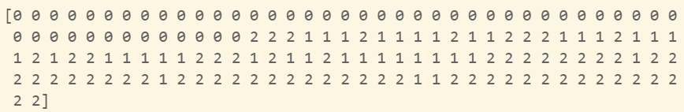
Prediction
Classification by output value
## Decision phase
set_opt = ada_set.net_input(X_std)
ver_opt = ada_ver.net_input(X_std)
vir_opt = ada_vir.net_input(X_std)
judgment = np.concatenate((set_opt.reshape(150,1), ver_opt.reshape(150,1)), axis=1)
judgment = np.concatenate((judgment, vir_opt.reshape(150,1)), axis=1)
# print(judgment)
y_hat = np.argmax(judgment, axis=1)
print('y_hat=', y_hat)

Slide 9
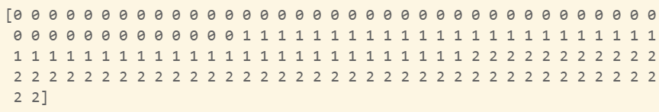
Multiclass classification
Multiclass label
## Produce ground truth
set_ = np.where(y == "setosa", 0, 2)
ver_ = np.where(y == "versicolor", 1, 0.5)
vir_ = np.where(y == "virginica", 2, 0.5)
set_ver = np.multiply(set_, ver_)
y_true = np.multiply(set_ver, vir_)
y_true = y_ture.astype(int)
print('y_true=', y_true)

Slide 10
Confusion matrix
Count ture0predict0, ture0predict1, … ture2predict2
## Measure of decision accuracy
result = y_hat*3 - y_ture
t0p0 = y_ture.shape[0] - np.count_nonzero(result)
t0p1 = y_ture.shape[0] - np.count_nonzero(result-3)
t0p2 = y_ture.shape[0] - np.count_nonzero(result-6)
t1p0 = y_ture.shape[0] - np.count_nonzero(result+1)
t1p1 = y_ture.shape[0] - np.count_nonzero(result-2)
t1p2 = y_ture.shape[0] - np.count_nonzero(result-5)
t2p0 = y_ture.shape[0] - np.count_nonzero(result+2)
t2p1 = y_ture.shape[0] - np.count_nonzero(result-1)
t2p2 = y_ture.shape[0] - np.count_nonzero(result-4)
confusion_matrix = np.array([[t0p0, t0p1, t0p2],
[t1p0, t1p1, t1p2],
[t2p0, t2p1, t2p2]])
print('confusion_matrix='+'\n', confusion_matrix)

Slide 11
Confusion matrix (Cont.)
 | Pre_setosa | Pre_versicolor | Pre_virginica
True_setosa | t0p0 | t0p1 | t0p2
True_versicolor | t1p0 | t1p1 | t1p2
True_virginica | t2p0 | t2p1 | t2p2

Slide 12
b) Performance metrics
Find precision and so on
## Performance metrics
sum_tp = t0p0 + t1p1 + t2p2
sum_fp = (t1p0 + t2p0) + (t0p1 + t2p1) + (t0p2 + t1p2)
sum_fn = (t0p1 + t0p2) + (t1p0 + t1p2) + (t2p0 + t2p1)
precision = sum_tp/(sum_tp + sum_fp)
print('precision=', precision)
recall = sum_tp/(sum_tp + sum_fn)
print('recall=', recall)
f1_score = 2*(precision*recall)/(precision+recall)
print('f1_score=', f1_score)

Slide 13
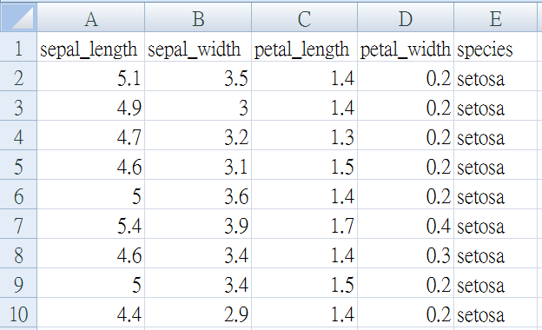
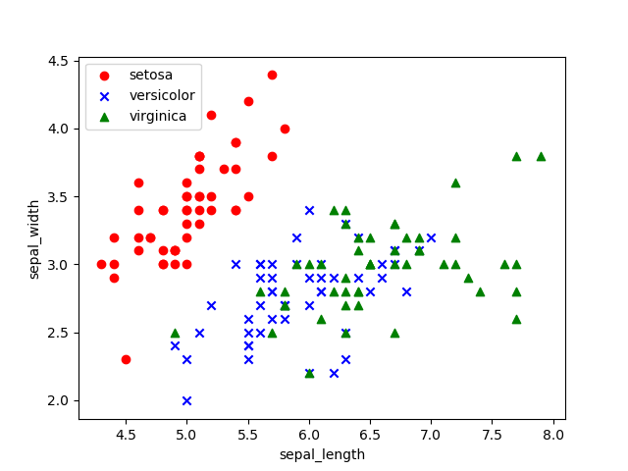
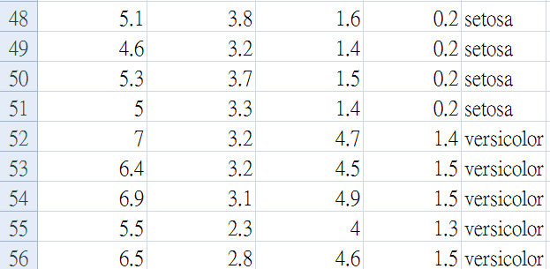
Select feature
Choose any 2 feature

Slide 14
Visualization
Using dictionary
p_dic_1 = {'x1':'sepal_length','x2':'sepal_width', 'r1':0, 'r2':1}
p_dic_2 = {'x1':'sepal_length','x2':'petal_length', 'r1':0, 'r2':2}
...
plot_type_dic = [p_dic_1, p_dic_2, p_dic_3, p_dic_4, p_dic_5, p_dic_6]
for plot_type in plot_type_dic:
# Plotting the Iris data
plt.scatter(X[:50, plot_type['r1']], X[:50, plot_type['r2']],
color='red', marker='o', label='setosa')
plt.scatter(X[50:100, plot_type['r1']], X[50:100, plot_type['r2']],
color='blue', marker='x', label='versicolor')
plt.scatter(X[100:150, plot_type['r1']], X[100:150, plot_type['r2']],
color='green', marker='^', label='virginica')
plt.xlabel(plot_type['x1'])
plt.ylabel(plot_type['x2'])
plt.legend(loc='upper left')
plt.show()

Slide 15
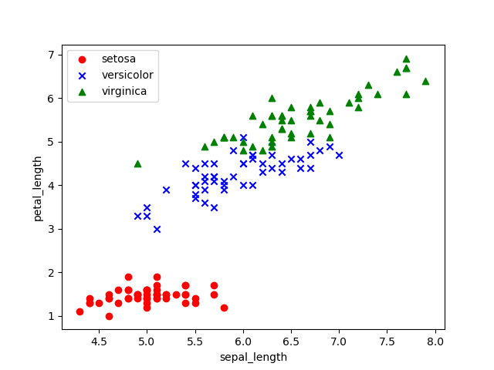
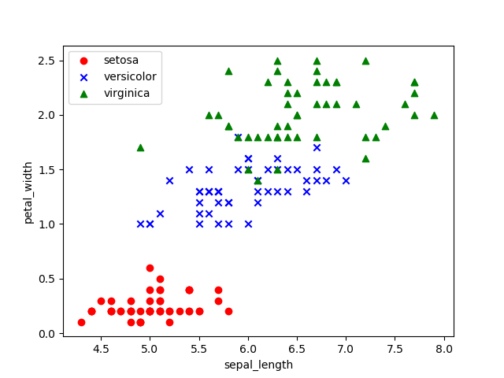
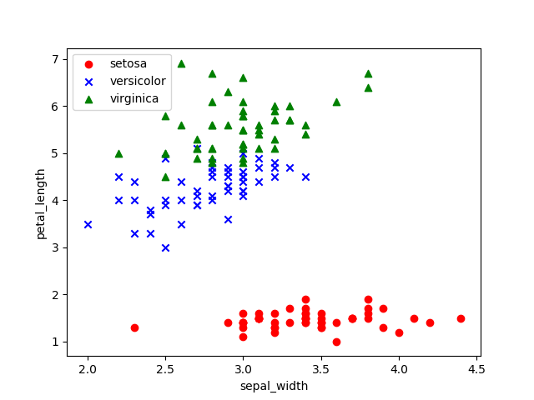
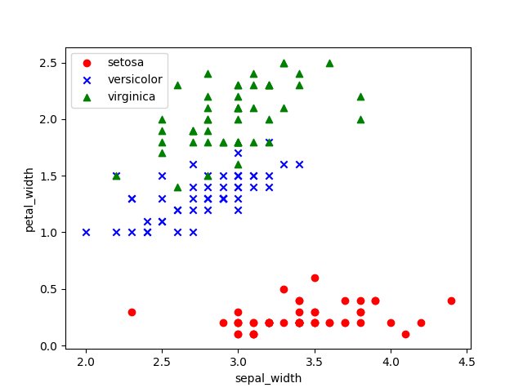
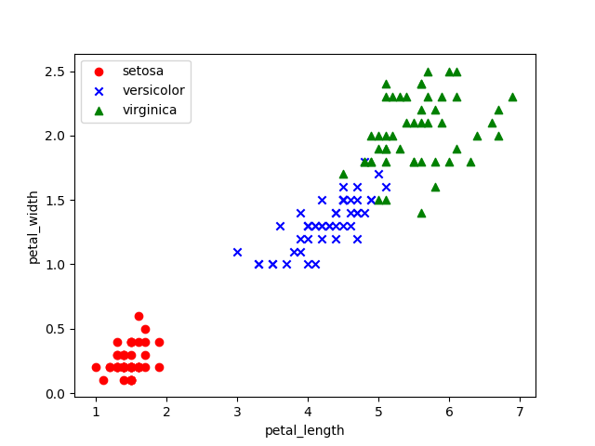
Visualization(cont.)
or

Slide 16
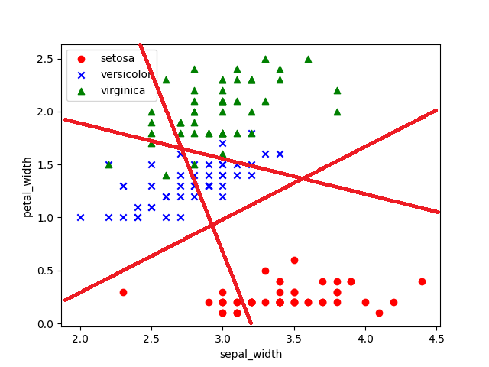
One-versus-All (using 2 features)

Slide 17
Another view (Correlation Matrix)
The relationships between features
import seaborn as sns
feature_name = ['sepal_length', 'sepal_width', 'petal_length', 'petal_width']
cm = np.corrcoef(df.iloc[:,[0, 1, 2, 3]].values.T)
# print(cm)
sns.set(font_scale=1.25)
hm = sns.heatmap(cm, cbar=True, annot=True, square=True, fmt='.2f', annot_kws={'size': 10},
yticklabels=feature_name, xticklabels=feature_name, cmap="Blues")
plt.tight_layout()
plt.show()

Slide 18
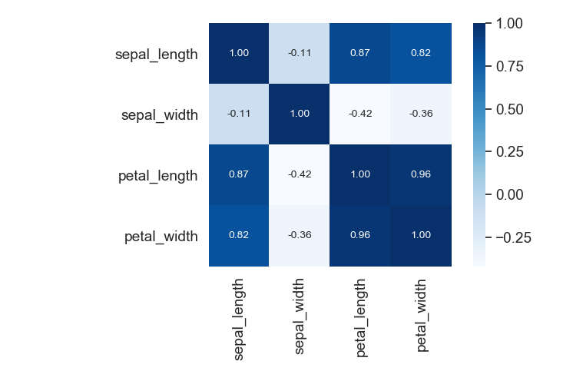
Correlation Matrix

Slide 19
Feature 1 | Feature 2 | F1 | Correlation
sepal_length | sepal_width | 0.78 | -0.11
sepal_length | petal_length | 0.793 | 0.87
sepal_length | petal_width | 0.7 | 0.82
sepal_width | petal_length | 0.813 | -0.42
sepal_width | petal_width | 0.846 | -0.36
petal_length | petal_width | 0.780 | 0.96
All feature |  | 0.86

Slide 20
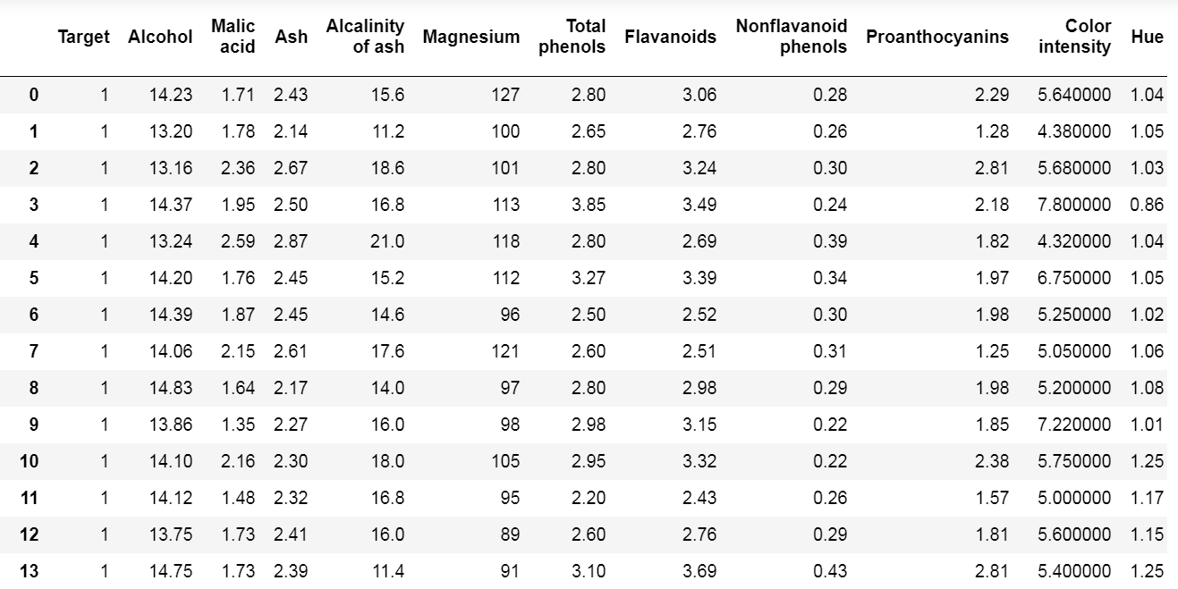
Multidimensional features
…

